Slide 1

Supercharge every spoonful 每一勺都充满活力
Innovative pairings for yoghurt to break through – FBIF, May 8, 2025 创新酸奶搭配突破传统 – FBIF，2025年5月8日

Slide 2
Katie Verlaan
Global Marketing Lead for Protein ingredients - FrieslandCampina Ingredients 全球蛋白质原料营销负责人 - FrieslandCampina Ingredients
Responsible for Marketing, Strategy, Innovation & NPD 负责市场营销、战略、创新及新产品开发 (NPD)
…. years' experience with focus on …. ……年专注于……的经验
Include photo Katie 包含Katie的照片
@Olivia- would you be able to make a page here that is in line with other presentations that have been given? @Olivia- 你能否制作一个与此处其他已提交的演示文稿一致的页面？

Slide 3

Yoghurt: Tried, tested and trusted – now reimagined 酸奶：经过考验并值得信赖——现在重新想象
Yoghurt is back in the spotlight – perfect for consumers who want holistic health support in an enjoyable, familiar and often indulgent format. Take your yoghurt’s health benefits to the next level with added: 酸奶再次成为焦点——适合希望以愉悦、熟悉且常带享受的形式获得全面健康支持的消费者。通过添加以下成分将酸奶的健康益处提升到更高水平：
Prebiotics for enhanced gut health positioning 益生元以增强肠道健康定位
DHA for cognitive health support DHA 支持认知健康
Protein fortification for muscle health, recovery and satiety 蛋白质强化以促进肌肉健康、恢复和饱腹感

Slide 4
Globally, Yogurt is a growing market, with plain (spoonable) yogurt category showing the highest projected growth 全球范围内，酸奶市场正在增长，其中普通（可舀取）酸奶类别显示出最高的预期增长率
CAGR, 2020-24 % 复合年增长率，2020-24 %
CAGR, 2024-29 % 复合年增长率，2024-29 %
Key dynamics 关键动态
Global Demand of yoghurt by type, €Bn 全球各类酸奶需求，€Bn
Drinking Yogurt 饮用酸奶
Flavoured Yogurt 风味酸奶
Plain Yogurt 普通酸奶
Global increase in demand for yoghurts. Expected to accelerate driven largely by strong consumer trends: 全球对酸奶的需求增加。预计将在强劲的消费者趋势推动下加速增长：
Increased consumption of fortified foods 强化食品消费增加
Changing demographics (GenZ, Ageing population) 人口结构变化（Z世代，老龄化人口）
GLP-1 usage boosting ongoing health & wellness trends GLP-1 使用促进持续的健康与 wellness 趋势
+4.9%
111
105
+3.4%
94
99
4.6
6.6
87
90
85
76
0.1
2.6
4.2
3.8
2020
2023
2024
2025
2026
2027
2028
2029
Source: Euromonitor 资料来源：Euromonitor
Notes:
Demographics changing with GenZ becoming an increasing share of the
consuming population and showing higher tendency towards H&W trends - e.g.,
35% of GenZ intent to buy products with high protein share vs 11% of Gen X

Slide 5
Although a declining market, the future of yoghurt in China is in no way bleak. Flattening decline & very positive consumer trends. 尽管市场在下滑，但中国酸奶的未来绝非黯淡。下降趋势趋于平稳，且消费者趋势非常积极。
CAGR, 2020-24 % 复合年增长率，2020-24 %
CAGR, 2024-29 % 复合年增长率，2024-29 %
Key dynamics 关键动态
China Demand of yoghurt by type, €Bn 中国各类酸奶需求，€Bn
China is expected to stabilize in yoghurt category size, after a period of significant decline. increase in demand for high-end whey proteins through GLP-1 在经历了一段显著下滑后，中国酸奶类别的规模预计将会稳定。通过GLP-1，高端乳清蛋白的需求增加。
Drinking Yogurt 饮用型酸奶
Flavoured Yogurt 风味酸奶
Plain Yogurt 原味酸奶
18,0
-4.2%
1,8
-5.5
0.6
1,9
14,3
-1.1%
Sizeable market (15% of global size) with significant presence in drinking yoghurt 市场规模可观（占全球市场的15%），在饮用型酸奶领域有显著存在。
Despite recent decline, there are significant opportunities to grow driven by new health & well-ness trends 尽管最近有所下滑，但在新的健康与 wellness 趋势推动下，仍存在显著的增长机会。
1,5
12,9
12,2
1,5
1,4
11,8
11,6
11,8
12,1
1,4
1,3
1,3
1,3
1,3
1,3
1,3
1,3
1,4
1,4
-6.5
-1.5
1,3
14,3
11,3
10,2
9,6
9,2
9,0
9,1
9,3
-6.8
-0.3
2020
2023
2024
2025
2026
2027
2028
2029
Source: Euromonitor 资料来源：欧睿国际

Slide 6



We see at least 3 significant and different ways to either grow the market, or grow your share within the market 我们看到了至少三种显著且不同的方法，可以用来扩大市场或增加你在市场中的份额。
CREATE NEW OCCASIONS
ATTRACT NEW CONSUMER GROUPS
TAP INTO FUNCTIONAL BENEFITS
When, why & how people consume yoghurts 人们何时、为何以及如何消费酸奶。
Who consumes & what benefits are they looking for 谁在消费以及他们寻求哪些好处。
Consumers are looking for additional benefits. 消费者正在寻找额外的好处。
What & why? 什么与为什么？

Slide 7

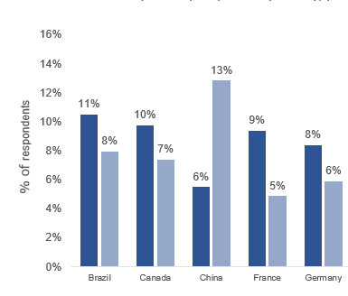
There is opportunity in positioning around health & pleasure, and exploring different occasions (time of day consumption) 围绕健康与愉悦进行定位，并探索不同的消费场合（一天中的不同时间段）存在机会
Health, taste and convenience are the top three reasons for consuming yoghurt 健康、口味和便利性是食用酸奶的三大原因
Healthy food is already seen as a source of pleasure & reward in China 在中国，健康食品已经被视为愉悦和奖励的来源
Yoghurt is consumed, to varying degrees, throughout the day 酸奶在一天中的不同时间段被不同程度地消费
Why do you usually consume yoghurt? Select up to five (Top 10 reasons) (Global, 2024) 1 您通常为什么食用酸奶？请选择最多五个原因（全球，2024年）1
What have been the most important sources of pleasure and reward for you in the past 12 months? (Global 2022) 在过去12个月中，哪些是最重要的愉悦和奖励来源？（全球，2022年）
When do you typically consume this product? Select up to three (Global, 2024) 1 您通常在什么时候食用这种产品？请选择最多三个时间点（全球，2024年）1
% of consumers 消费者比例
% of consumers
% of consumers
Source: FMCG Gurus, Innova Lifestyle & Attitudes Survey 2022. Innova Category Survey 2024 资料来源：FMCG Gurus，Innova 生活方式与态度调查 2022。Innova 类别调查 2024

Slide 8


KIDS 儿童
ACTIVE AGEING 积极老龄化

Slide 9

Our kids, the future thinkers, creators, and leaders 我们的孩子，未来的思考者、创造者和领导者
KIDS
Brain & cognitive processing 大脑与认知处理
Maturation of the immune system 免疫系统的成熟
Mental 心理健康
well-being 福祉
Linear 线性
growth & body composition 生长与体成分
Bone mineralization 骨骼矿化

Slide 10








Market China | An “all-in-one” solution is desired from the Chinese parents 中国市场 | 中国家长希望获得“一站式”解决方案
KIDS 儿童
Multiple health Benefits 多种健康益处
Well resonated Ingredients 广受认可的成分
DHA
Protein 蛋白质
Lactoferrin 乳铁蛋白
Prebiotics 益生元
Lutein 叶黄素
Probiotics 益生菌
Vitamins 维生素
Minerals 矿物质
Brain health 大脑健康
Gut health 肠道健康
All in one 一站式
Growth & height 生长与身高
Immune 免疫
health 健康
Eye health 眼睛健康
Formats 形式
Spoonable yoghurt 勺食酸奶
Ready-to-drink 即饮型

Slide 11
Consumers are changing their attitude towards a more preventative & holistic approach to health 消费者正在改变他们的态度，转向更加预防性和全面的健康方法
ACTIVE AGEING 积极老龄化
In order to live healthily, which approach do you tend to follow? (global,2024) 为了健康生活，你倾向于遵循哪种方法？（全球，2024）
1
Younger people increasingly consider their current lifestyle choices might affect their long-term health 年轻人越来越意识到他们当前的生活方式选择可能会影响他们的长期健康
2
2,7X 2,7倍
Population growth 人口增长
In the population over age 65 expected between 1990 and 2050 预计1990年至2050年间65岁以上人口
1. Innova market research, 2023 1. Innova 市场研究，2023
2. “World population ageing 2019: Highlights,” United Nations, Department of Economic and Social Affairs, 2019 2. “世界人口老龄化 2019：亮点”，联合国经济和社会事务部，2019
Notes:
1 (and 2) One of the Innova 2024 trends - Prioritizing prevention: positive action to prevent health concerns before they arise is driving consumers to products that meet their personal well-being needs for a longer, healthier life
2. Aging population is increasing worldwide
3: The South Korean government has hailed the success of a national food industry strategy that has reduced frailty, nutrition, and malnutrition rates among the elderly population. They government introduced an ‘S mark’ (senior friendly foods: based on parameters such as product hardness, viscosity, nutritional content, and more) certification that these products are able to display on their food labelling.

Slide 12
Aging population is increasing worldwide, and the geography of the world's oldest countries is shifting from Europe towards SE Asia by 2050 全球老龄化人口正在增加，到2050年，世界上最老的国家的地理分布将从欧洲向东南亚转移。
1273 M
Number and distribution of people aged 60 years or over by region 各地区60岁及以上人口的数量和分布
In 2017 and 2050 2017年和2050年
Distribution of older people in 老年人口分布
2080 M
2017
549 M
183 M
247 M
78 M
123 M
57%
increase
35%
increase
962
132%
increase
NORTH AMERICA
EUROPE
2050
ASIA
198 M
226 M
76 M
161%
increase 增加
69 M
229%
increase
93%
increase
7 M
13 M
GLOBAL 全球
LATIN AMERICA
AFRICA
OCEANIA
Source: United Nations, 2017 资料来源：联合国，2017年
Source: United Nations, World social Report, 2023 资料来源：联合国，世界社会报告，2023年
Notes:
It is a well known fact that global population is aging and that Asia is leading this process in terms of absolute number of aging individuals. Together with this demographic change, there is also emerging science on how the aging process develops and how it can be influenced.

Slide 13









Generational approach: different generations, different needs 代际方法：不同的世代，不同的需求
Gen Z Z世代
Millennials 千禧一代
Gen X X世代
Boomers 婴儿潮一代
Weight management 体重管理
Skin Health 皮肤健康
Heart health 心脏健康
Weight management 心脏健康
Heart Health
Energy & stamina 能量与耐力
Weight management
Heart Health
Bone / Joint Health 骨骼/关节健康
Heart Health
Weight management
Bone / Joint Health
Difference in concerns about healthy aging 对健康老龄化的关注点差异
Protein 蛋白质
Minerals 矿物质
Protein
Vitamins
Fibers
Vitamins 维生素
Fibers 纤维
Omega-3 欧米伽-3
Difference in ingredients that are important 重要成分的差异
Difference in aspects and formats that are important 重要的方面和格式的差异
Preserving looks/appearance 保持外观
Keeping an active mind 保持活跃的思维
1. Innova market research, 2023 1. Innova市场研究，2023

Slide 14
Whilst small, we see that Functional yoghurts are growing significantly, and adding value to the category 尽管规模较小，但我们看到功能性酸奶正在显著增长，并为品类增加价值
@Olivia- this slide needs some attention from a formatting perspective. @Olivia- 这张幻灯片需要从格式上进行一些调整。
Global numbers 全球数据
China numbers 中国数据
2023-2029 CAGR 2023-2029年复合年增长率
-4.8
58,2
4.5
45,0
75.053
10.214
4.6
5,9
6,0
7.248
1,5
59.068
Good Source of Minerals Yoghurt 富含矿物质酸奶
Good Source of Vitamins Yoghurt 富含维生素酸奶
High Fibre Yoghurt 高纤维酸奶
High Protein Yoghurt 高蛋白酸奶
Probiotic Yoghurt 益生菌酸奶
55.207
Average price per KG (in EUR) 平均价格（每公斤，欧元）
-2.8
1.6
3,9
3,9
3,4
1.8
43.053
2.950
2,8
1.8= ave. €/kg total yoghurt 1.8 = 平均每公斤酸奶的总价格（欧元）
2.707
2.637
36.070
2.222
1,5
31.906
Good Source of Minerals Yoghurt
Good Source of Vitamins Yoghurt
High Fibre Yoghurt
High Protein Yoghurt
Probiotic Yoghurt
Drinking Yogurt 饮用型酸奶
Spoonable Yogurt 勺食型酸奶
Functional Yogurt 功能性酸奶
Drinking yoghurt 饮用型酸奶
Spoonable yoghurt 勺食型酸奶
Functional yoghurts 功能性酸奶
XX
CAGR (’24-’30) 复合年增长率（2024-2030）
Market Value (in M EUR, 2024) 市场价值（2024年，百万欧元）
Market Value (in M EUR, 2030) 市场价值（2030年，百万欧元）
Source: Euromonitor (incl. fermented & ambient) 资料来源：欧睿国际（包括发酵和常温产品）
Notes:
Drinking yoghurt: ​Includes dairy based drinking yoghurts of all types (full fat, low fat, flavoured, fruited, plain, etc), regardless of flavour (eg, strawberry, banana raspberry, etc) are included. Drinking yoghurts explicitly positioned towards children (and in some cases featuring a toy/surprise) is also included here regardless of flavour. Drinking fromage frais, also typically positioned for children is included here. Includes both normal/regular drinking yoghurt as well as products with a “functional” positioning.​ (fermented)
Spoonable yoghurt: ​Aggregation of Flavoured and Plain (Spoonable) Yoghurt​
Functional yoghurt​: Aggregation of all functional segments (Good source of Vitamins, Good source of Minerals, Good source of Anti-oxidants, High fiber, High protein & Probiotic)​. These functional yoghurt categories include both drinking and non-drinking yoghurt (plain and flavoured). This includes chilled and shelf stable yoghurt. Plant based-based yoghurts are included.

Slide 15
Actually, functionality is becoming a norm in the yoghurt innovation landscape 实际上，功能性正在成为酸奶创新领域的新常态
Figure: 图：
% of yogurt launches with one or more functional claims within overall yogurt launches (Global 2024; CAGR 2024 vs 2020) 具有一个或多个功能性声明的酸奶新品发布在全球酸奶新品发布中的占比（全球2024年；2024年对比2020年的复合年增长率）
0%
CAGR
+4%
CAGR
NAM
APAC
81%
52%
+18%
CAGR
CHINA
EUROPE
39%
LATAM
+15%
CAGR
48%
39%
-4%
CAGR
+4%
CAGR
ANZ
60%

Slide 16

Notes:
On top of all of this, we have the recent insurgence of GLP-1 which is driving another level of dynamic on top of the trends we are seeing in the market.

Slide 17
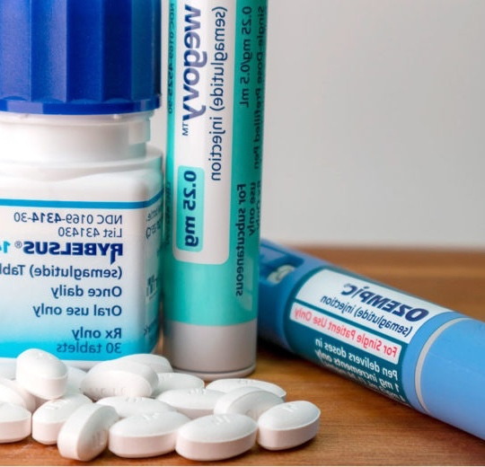




The Anti Obesity Medicines (AOMs): market is much bigger and growing faster than anticipated 抗肥胖药物（AOMs）市场比预期的更大且增长更快
~40% Americans1 ~1 bln people 20302 约40%的美国人1 2030年约10亿人2
10-12% adults2 (25-30 mln.) 10-12%的成年人2 （2500万-3000万人）
+ > 300%⁴
US 2020-2023 美国 2020-2023年
$14 bln2 Ozempic & Wevogy #1 drug sales 140亿美元2 诺美亭和韦沃吉药物销售额排名第一
Source1 CDC, 09-2024 National Health and Nutrition Examination Survey 资料来源1 疾控中心，2024年9月全国健康与营养调查
2.iSearch-DNA - Rabobank: Anti-obesity medications - Will the food industry be the biggest loser? (Dec 2024) 2.iSearch-DNA - 拉博银行：抗肥胖药物 —— 食品行业会成为最大的输家吗？（2024年12月）
3. CNN 2024, KFF Survey Health Tracking Poll May 2024: The Public’s Use and Views of GLP-1 Drugs 3. CNN 2024年，KFF健康追踪民意调查2024年5月：公众对抗肥胖药物GLP-1的使用和看法
4. IQVIA MIDAS, Jun 2023; IQVIA Institute, Dec 2023 4. IQVIA MIDAS，2023年6月；IQVIA研究所，2023年12月
Notes:
So what is the impact of AOM's. Well, let's throw in some numbers, so you have an idea what we are talking about. Recent CDC publication showed that currently about 40% of adult Americans are actually obese. And if we look at the projection of the World obesity federation, they predict that by 2030 1 bln people worldwide will be obese. So that is a tremendous amount of people. Ok, I will buy that. That's a lot. But surely not all of them will be using AOM medication, right. Right, not all of them, but to give you a bit of an idea, a recent KFF survey reported that 1 out of 8 of all American adults is actually using an AOM, translating to a current number of 15 mln. Which you could call substantial. Ok, ok, quite a lot of current users, what about when the usage has been stagnant. Well, over the period of 2020-2023 the prescription of AOM's in the US has increased by a staggering 300%. And if we look at the forecasted growth numbers, there are several sources, but Grand View Research, places the growth number for the AOM of 32% of 2024-2030. So we can imagine quite a lot of potential impact coming from this factor. Ok, so it is a relevant factor. But what are actually AOM's and why do people use them.

Slide 18




Anti Obesity Medicines (AOMs): 抗肥胖药物 (AOMs):
GLP 1:glucagon-like peptide-1 is a naturally occurring hormone. Its role is to increase insulin after a meal, to break down sugar in the body. GLP 1: 胰高血糖素样肽-1 是一种天然存在的激素。其作用是在餐后增加胰岛素，以分解体内的糖分。
GLP 1 Agonists: Medication that mimics GLP-1 in the body, and supports the management of type 2 diabetes (& more recently obesity)1 GLP 1 激动剂：模仿体内 GLP-1 的药物，支持 2 型糖尿病的管理（最近也用于肥胖症）1
Suppresses appetite 抑制食欲
Increases satiety after a meal 增加餐后的饱腹感
Resulting in weight loss, including loss of muscle mass, and possible dehydration and gut health issues. 导致体重减轻，包括肌肉质量的减少，以及可能的脱水和肠道健康问题。
Source: 1: GLP-1 Agonists: What They Are, How They Work & Side Effects (clevelandclinic.org) 来源: 1: GLP-1 激动剂：它们是什么，如何工作及副作用 (clevelandclinic.org)
Notes:
AOM, what is it and what does it do?
The most well-known version is GLP-1, Glucagon-Like Peptide 1, I am not an expert, but when quoting sources and simplifying the actions of the medicine, we come to the following relevant actions for our storyline. it is actually a naturally occuring human hormone. And it is prescribed to support managing type 2 diabetes and obesity. By support to suppress appetite, increase satiety after a meal and decreases the insuline response after a meal. OK, that is all clear. So there is a huge potential impact and AOM's support obese people but what does that all have to do with protein and increasing demand.
AOM, what is it and what does it do? GLP-1 Agonists: What They Are, How They Work & Side Effects (clevelandclinic.org)

Slide 19

The impact of GLP-1 drugs beyond diabetes and weight loss opportunities for companion products GLP-1药物在糖尿病和减肥之外的影响及伴随产品的机会
Nausea occurrence in ~40% of users 约40%的用户出现恶心
Vomiting ~20% of users 约20%的用户出现呕吐
Diarrhea ~20% of users 约20%的用户出现腹泻
PHYSICAL SIDE EFFECTS OF GLP-1 DIETS GLP-1饮食的物理副作用
Constipation 4-12% of users 4-12%的用户出现便秘
Concerns of muscle mass loss 担心肌肉质量损失
Smaller portions 减少食量
SOCIAL IMPACT OF GLP-1 DIETS GLP-1饮食的社会影响
Healthier food choices 更健康的食物选择
Changing food & beverage spending 改变食品和饮料支出

Slide 20
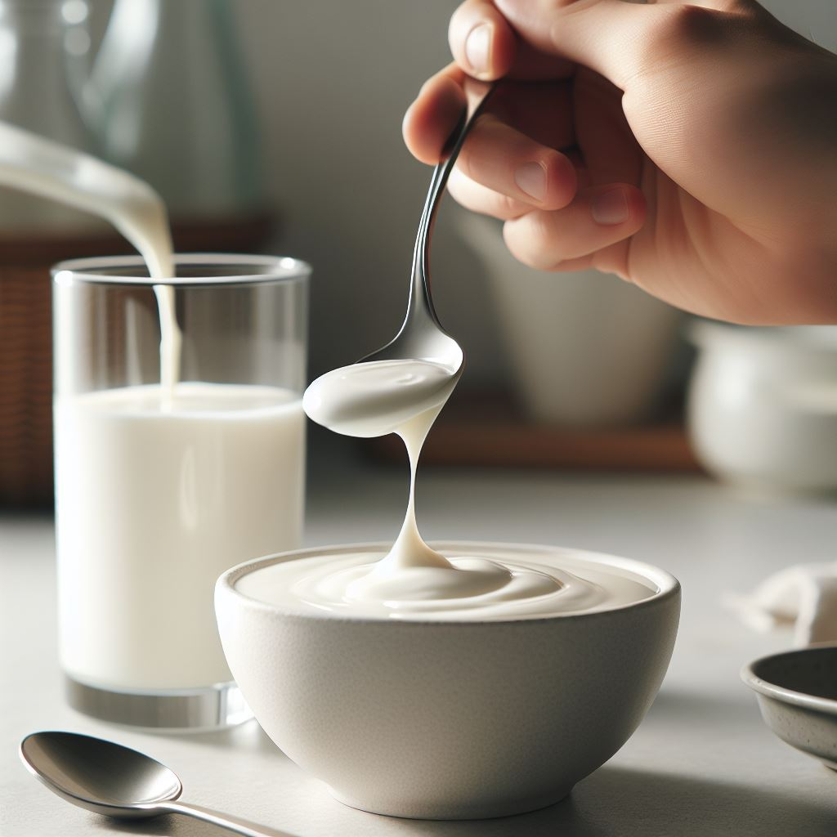
Responding to the changing consumer needs can be challenging 应对不断变化的消费者需求可能具有挑战性

Slide 21
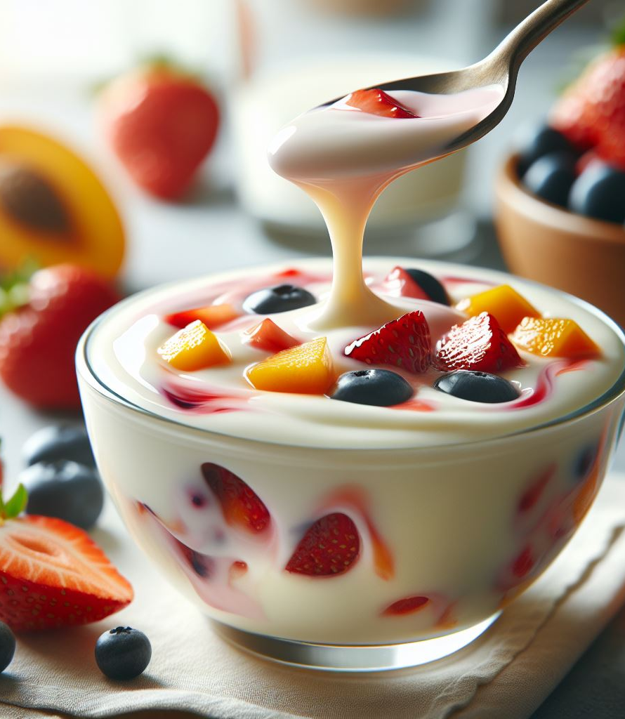
These are a few of the challenges we hear about 这是我们听到的一些挑战
@Olivia- this slide needs some attention from a formatting perspective. @Olivia- 这张幻灯片在格式方面需要一些关注。
High levels of protein can negatively impact taste & viscosity 高蛋白水平可能对口感和粘度产生负面影响
Different proteins for different protein levels 不同蛋白质水平需要不同的蛋白质
Some ingredients, f.e DHA, can really impact taste negatively 某些成分，例如DHA，可能会严重影响口感
Different proteins for different processes, drinks and spoonable yoghurts 不同的蛋白质适用于不同的工艺、饮料和可勺食酸奶
Different ingredients need to work together in the end solution 不同的成分最终需要协同工作
Regulatory framework can be difficult to navigate 监管框架可能难以驾驭

Slide 22





So, what's the secret to success? 那么，成功的秘诀是什么？
Nutrition
Science-backed ingredients 科学支持的成分
Understanding the modern family 理解现代家庭
Taste
Cost
Appeal
Recipe design 配方设计
Regulatory guidance 监管指导
It is a balancing act 这是一个平衡的艺术
FCI has powerful tools to help you FCI 拥有强大的工具来帮助您

Slide 23






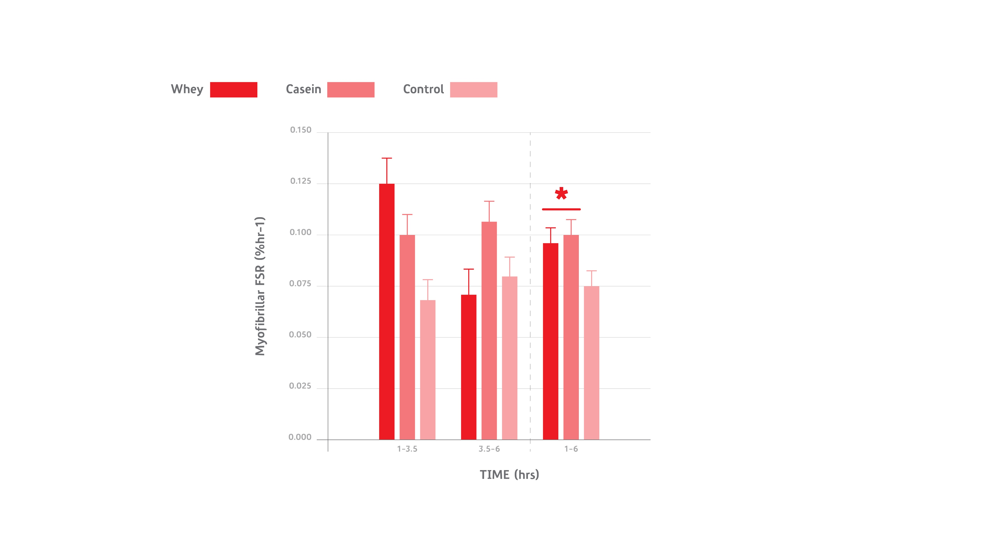
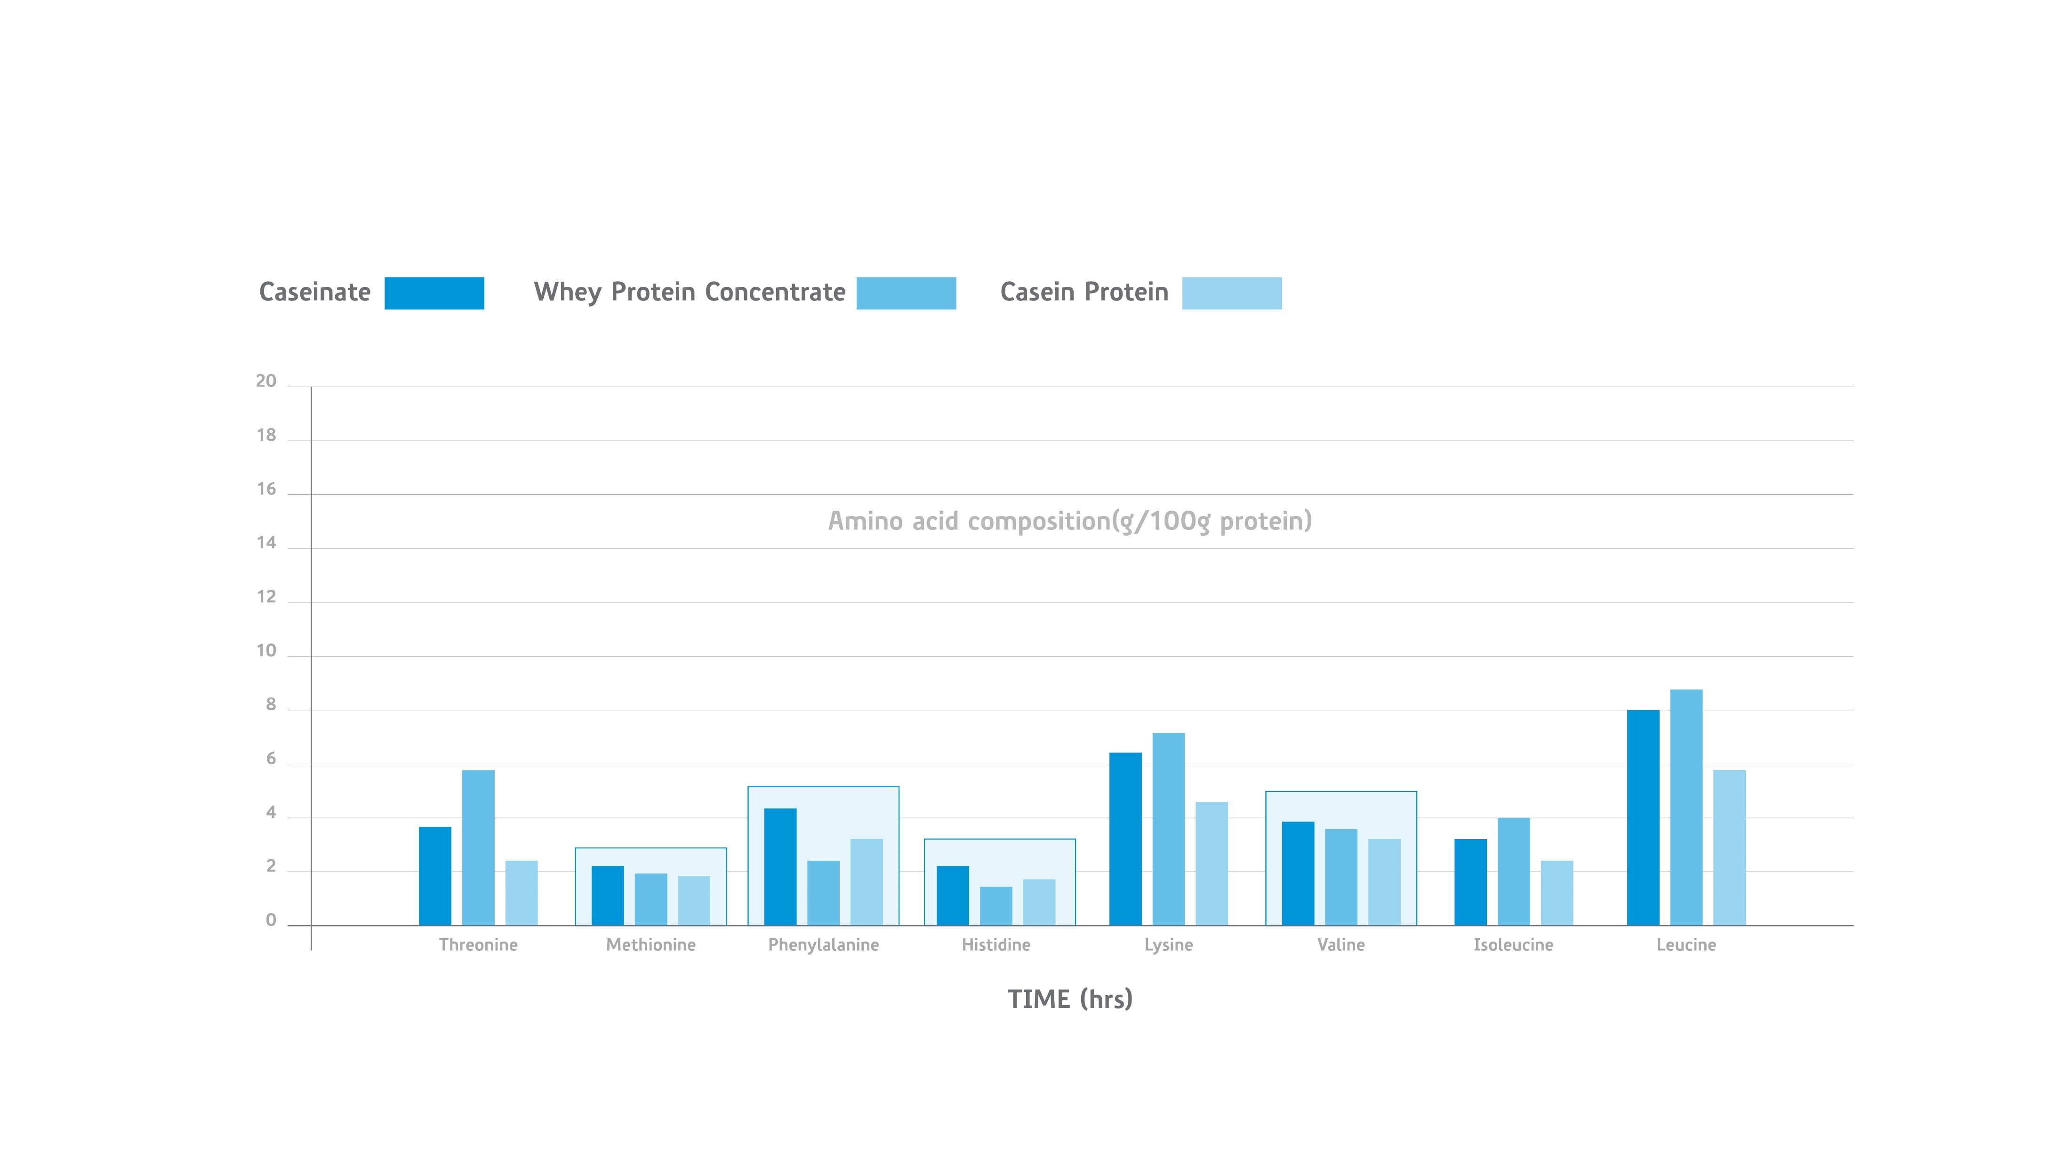
Casein Protein: from underdog to champion 酪蛋白：从冷门到冠军
Heat 热
stability 稳定性
Nutritional 营养
Value 价值
Clean 纯净
Flavour 风味
Versatile 多功能
Whey protein works fast, but casein protein wins over time 乳清蛋白快速起效，但酪蛋白长期获胜
longer lasting muscle protein synthesis1 更持久的肌肉蛋白质合成1
shown to stimulate a higher level of muscle protein synthesis over a 6-hour period2 研究表明在6小时内能刺激更高水平的肌肉蛋白质合成2
ideal protein to support prolonged muscle recovery overnight3 理想的蛋白质，支持夜间长时间的肌肉恢复3
High in key essential amino acids 富含关键必需氨基酸
higher levels of several essential amino acids – histidine, methionine, phenylalanine and valine – than whey protein3 几种必需氨基酸——组氨酸、蛋氨酸、苯丙氨酸和缬氨酸——的含量高于乳清蛋白3
1. Reitelseder et al., Am J Physiol Endocrinol Metab , 2011​ 1. Reitelseder 等人, Am J Physiol Endocrinol Metab, 2011
2. Lacroix, M., Bos, C., Léonil, J., Airinei, G., Luengo, C., Daré, S., Benamouzig, R., Fouillet, H., Fauquant, J., Tomé, D. and Gaudichon, C. (2006). Compared with casein or total milk protein, digestion of milk soluble proteins is too rapid to sustain the anabolic postprandial amino acid requirement. The American Journal of Clinical Nutrition, 84(5), pp.1070–1079. doi:https://doi.org/10.1093/ajcn/84.5.1070. 2. Lacroix, M., Bos, C., Léonil, J., Airinei, G., Luengo, C., Daré, S., Benamouzig, R., Fouillet, H., Fauquant, J., Tomé, D. 和 Gaudichon, C. (2006). 与酪蛋白或全乳蛋白相比，乳溶性蛋白的消化速度过快，无法维持餐后合成代谢所需的氨基酸。《美国临床营养学杂志》，84(5)，第1070-1079页。doi:https://doi.org/10.1093/ajcn/84.5.1070.
3. Gorissen, S.H.M., Crombag, J.J.R., Senden, J.M.G. et al. Protein content and amino acid composition of commercially available plant-based protein isolates. Amino Acids 50, 1685–1695 (2018). https://doi.org/10.1007/s00726-018-2640-5 3. Gorissen, S.H.M., Crombag, J.J.R., Senden, J.M.G. 等人. 市售植物蛋白分离物的蛋白质含量和氨基酸组成。《氨基酸》50，1685-1695 (2018). https://doi.org/10.1007/s00726-018-2640-5

Slide 24




How to level up your high protein drink/ yoghurt 如何提升您的高蛋白饮品/酸奶
Strong market push for high protein products 高蛋白产品市场推动强劲
High protein drinks can get more potential interest 高蛋白饮品可获得更多潜在关注
Challenges when formulating high protein drinks 配制高蛋白饮品时的挑战
Nutri WheyTM ProHeat supports leveling up your high protein drinks Nutri WheyTM ProHeat 支持提升您的高蛋白饮品
Unlocking whey for high protein drinks 解锁乳清用于高蛋白饮品
Delivering on superior sensory; maintaining drinkability in high protein drinks, great clean taste, no powdery and grainy mouthfeel 提供卓越的感官体验；保持高蛋白饮品的可饮用性，口感清爽，无粉状和颗粒感
Offering significant resistance to heat treatments at high protein concentrations 在高蛋白浓度下提供显著的耐热性能

Slide 25
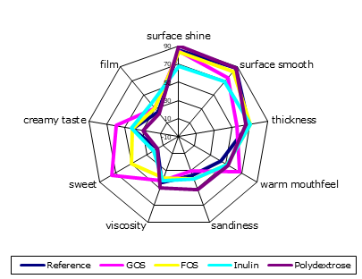

GOS offers improved sensory experience GOS 提供了改进的感官体验
GOS sensory benefits: GOS 的感官优势：
High compatibility with dairy taste 与乳制品口味高度兼容
Improved creamy and sweet taste 改善了奶油味和甜味
Warm mouthfeel, low sandiness, less chalky 温暖的口感，低砂感，较少的粉质感
Low impact on thickness and viscosity of yoghurt 对酸奶的厚度和粘度影响较小
Compared to other commonly used prebiotics 与其他常用的益生元相比
improved creamy taste 改善了奶油味
more sweet taste 更甜的口感
improved mouthfeel with least sandiness and least impact on thickness 改善了口感，砂感最少且对厚度的影响最小
Source: FCI Internal Research data 来源：FCI 内部研究数据

Slide 26
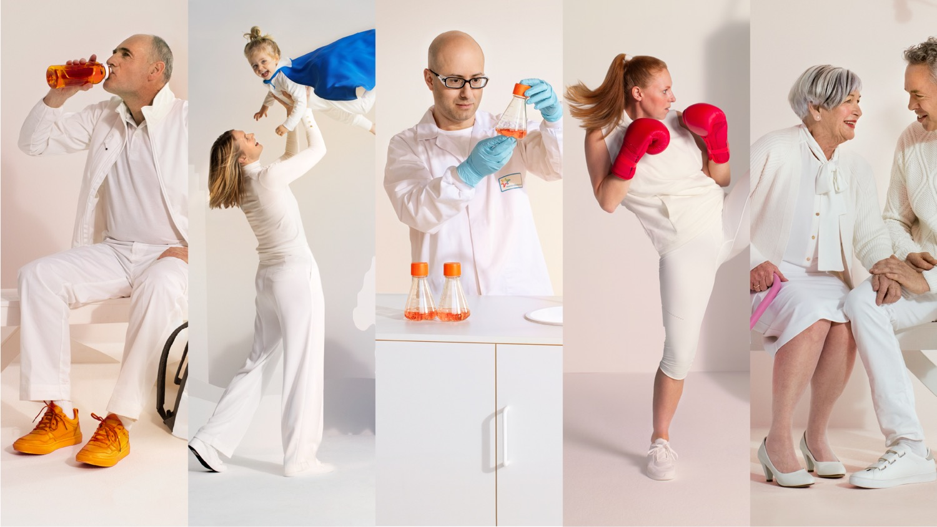
Who we are, what makes us tick and our key figures 我们是谁，我们的驱动力以及关键数据

Slide 27





Our facts & figures 2024 – FrieslandCampina Ingredients 我们的事实与数据 2024 – FrieslandCampina 成分
Export to
73
countries
1.45 billion
~1,700 employees
euros revenue
5
1 global innovation centre
international
offices for local presence
Notes:
2022 financial results
Number of employees per May 2023 (number of FTEs is 14,00)

Slide 28





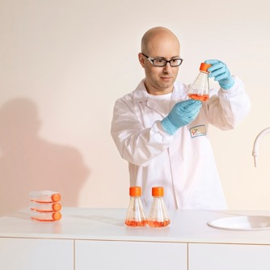
We are FrieslandCampina Ingredients 我们是FrieslandCampina Ingredients
We bring expertise and insights in a wide range of markets. We collaborate with our partners to develop nutritional health and well-being solutions for people in all life stages. 我们在广泛的市场中提供专业知识和洞察。我们与合作伙伴共同开发适用于各个生命周期阶段的营养健康和福祉解决方案。
We offer nutrition to get the most out of life. Always. 我们提供营养，帮助人们充分享受生活。始终如一。
PerformanceNutrition 运动营养
ActiveNutrition 活力营养
MedicalNutrition 医疗营养
Early Life Nutrition 早期生命营养
CellNutrition 细胞营养
Adult Nutrition 成人营养
Notes:
We bring expertise and insights in a wide range of markets. We collaborate with our partners to develop nutritional health and wellbeing solutions for people in all life stages.
We offer nutrition to get the most out of life. Always.
We offer nutrition in 5 different market segments, 3 in Adult Nutrition, and Early Life Nutrition and Cell Nutrition – more to come later.

Slide 29




Everything we do, starts with the end consumer in mind 我们所做的每一件事，都以终端消费者为中心。
It is our drive to help people get the most out of their lives at all stages of life, aided by specialised nutrition. From babies to the elderly. 我们的动力是帮助人们在生命的各个阶段都能充分享受生活，这得益于专业营养的支持，从婴儿到老年人。

Slide 30
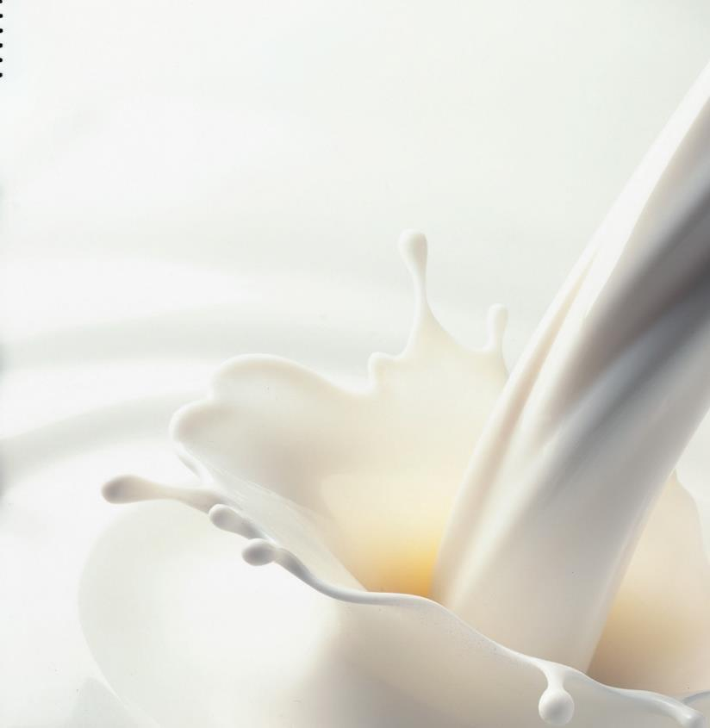





We are proud to nourish people around the globe with our ingredients 我们自豪地用我们的原料滋养全球人民
>30 m
20%
25 m
babies 婴儿
With our ingredients, we provide healthy food to millions of people worldwide 通过我们的原料，我们为全球数百万人民提供健康食品
Each year we supply ingredients for: 每年我们为以下需求提供原料：
athletes & active lifestyle consumers 运动员及积极生活方式消费者
of all medicine tablets worldwide 全球所有药片中的
LACTOSE 乳糖
BASEPOWDERS 基础粉
WHEY PROTEINSGOS 乳清蛋白 GOS
PROTEINS 蛋白质
LACTOSE
200 k
30+
different biological drugs and vaccines for treatment of a wide range of diseases 用于治疗多种疾病的30多种不同生物药物和疫苗
Babies with special dietary needs 有特殊饮食需求的婴儿
50 m
patients 患者
hydrolysates 水解物
caseinate 酪蛋白酸盐
hydrolysates
Notes:
Milk equivalents are 2021 figures, % calculated on total number of milk volume FC 2021
Note that the consumer impact numbers are calculated by taking the highest number of each end consumer/product group:
So for babies it’s 30M babies with our GOS (Borculo)
2M babies with our Lactose (Veghel)
1M babies with our basepowders (Borculo)
5M babies with our D90 (Bedum)
3M babies with our H35 (Workum)
For athletes it is
25M athletes (Veghel)
0,3M athletes (WPI, Borculo)

Slide 31










Acting in many parts of the innovation process and collaborating, can provide brand owners with know-how and speed to market in these areas 在创新过程的许多环节中行动并进行合作，可以为品牌所有者提供这些领域的知识和市场速度。
Ideation 创意构思
Science 科学
Co-development of applications 应用的共同开发
Manufacturing solutions 制造解决方案
Market positioning 市场定位
Extensive knowledge in relevant applications 相关应用的广泛知识
Regional technical presence 区域技术存在

Slide 32

@ team China, pease add here a QR code to the FCI WeChat page please- call to action- talk to our team at booth XXX @中国团队，请在此添加一个指向FCI微信页面的二维码——行动号召——在展位XXX与我们的团队交流
Can we add photos of the team and their positions? 我们能否添加团队成员的照片及其职位？
Questions 问题

